Slide 1
November 2022
Stroke Prediction
Tyler Schelling

Slide 2
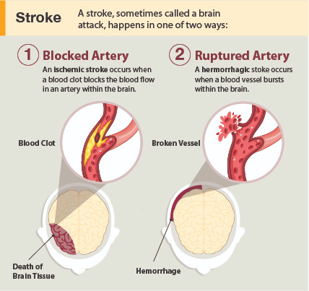
November 2022
Project Description
The purpose of this project is to predict a stroke outcome based on various data gathered from patients. Risk factors include age, gender, hypertension, heart disease, glucose levels, BMI, and more.
What is a stroke?
Per the CDC, a stroke occurs when something blocks blood supply to a part of the brain or when a blood vessel in the brain bursts. In either case, parts of the brain become damaged or die. A stroke can cause lasting brain damage, long-term disability, or even death.

Slide 3
November 2022
Stroke Dataset
The dataset was sourced from Kaggle - Stroke Prediction Dataset from the user ‘Federsoriano’.
According to the World Health Organization (WHO), strokes are the 2nd leading cause of death globally making them responsible for approximately 11% of total deaths.
This dataset utilizes 11 features for predicting stroke events.
Feature Name | Description | Feature Name | Description | Feature Name | Description
ID | Unique Identifier | Heart_disease | 0 (no) or 1 (yes) | Avg_glucose_level | Glucose level (mg/dL)
Gender | Male, Female, or Other | Ever_married | Yes or No | BMI | Body Mass Index (kg/m2)
Age | Age of the patient | Work_type | Child, Govt, Private, Self-employed, or Never | Smoking_status | Smoker, Former, Never, or Unknown
Hypertension | 0 (no) or 1 (yes) | Residence_type | Rural or Urban

Slide 4
November 2022
Stakeholders
This analysis will be utilized by a medical insurance company in order to assist with predicting stroke outcomes to push preventative care for patients that are higher risk.
Covering the cost of a stroke can range from $20,396 to $43,652. Preventative care can improve the health of patients as well as save the insurance company money for potential claims.

Slide 5
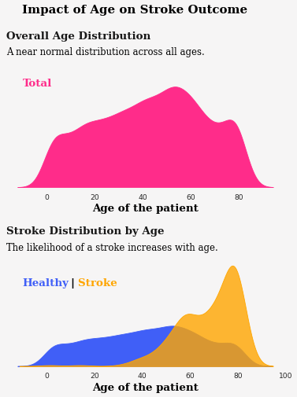
November 2022
Key Findings

Slide 6
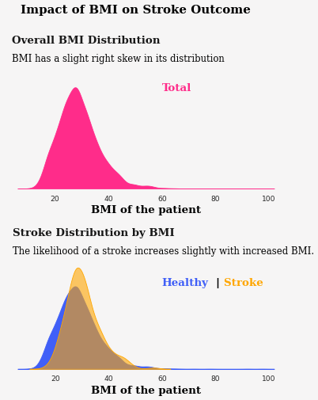
November 2022
Key Findings

Slide 7
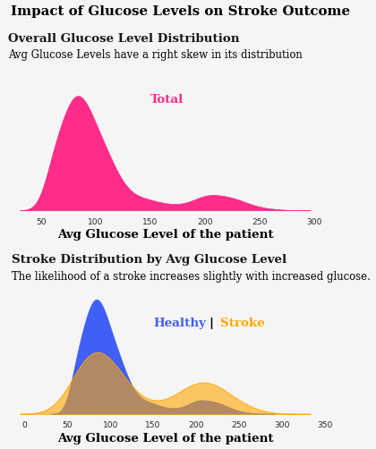
November 2022
Key Findings

Slide 8
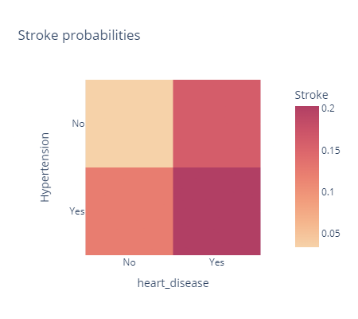
November 2022
Key Findings
The likelihood of a stroke is highest for patients that have both heart disease and hypertension.
Patients with either heart disease or hypertension also have an increased risk.
Patients that remain healthy (no heart disease or hypertension) have the lowest risk of having a stroke.

Slide 9
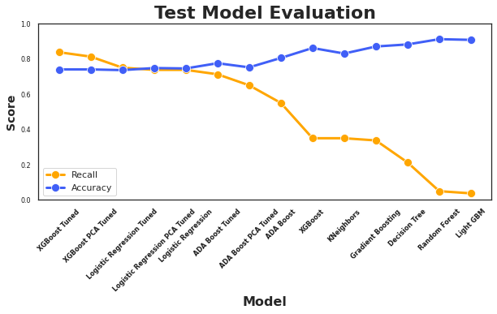
November 2022
Model Evaluation
The primary metric for evaluating the models will be recall (or what proportion of actual positives were correctly identified).
The best model that optimizes recall is a tuned XGBoost model.
Although the overall accuracy is 74.0%, the recall is the highest amongst the models at 83.8%
This means that almost 84% of the model’s predicted outcome of having a stroke were correct.

Slide 10
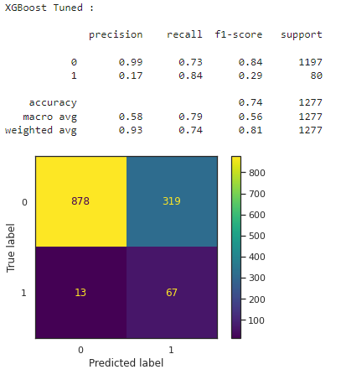
November 2022
Model Evaluation
Minimizing the false negatives will be the most beneficial for the insurance company.
Incorrectly predicting patients will not have a stroke when they actual do (false negative) can be costly to the company and does not provide adequate resources for preventative care to patients.
The downside to this model is the high rate of false positives. However, providing additional preventative care to patients that are likely not going to have a stroke will still be more cost effective than having a higher false negative rate.

Slide 11
November 2022
Recommendations
The tuned XGBoost model can lead to catching at risk patients early to provide the necessary preventative care and/or treatment.
False negatives are still a risk in the model and some predictions may require mild manual review in order to potentially catch any concerns not captured by the predictive model.
Aging patients, especially those with heart disease and/or hypertension, should seek medical care to get the appropriate preventative care with a medical professional.

